Slide 1
DSA 5101 Machine Learning Project
Xiong Jiajie A0251285E
Lan Rong A0169501H
Sun Wei A0244759N

Slide 2
Data preparation & Visualization

Slide 3
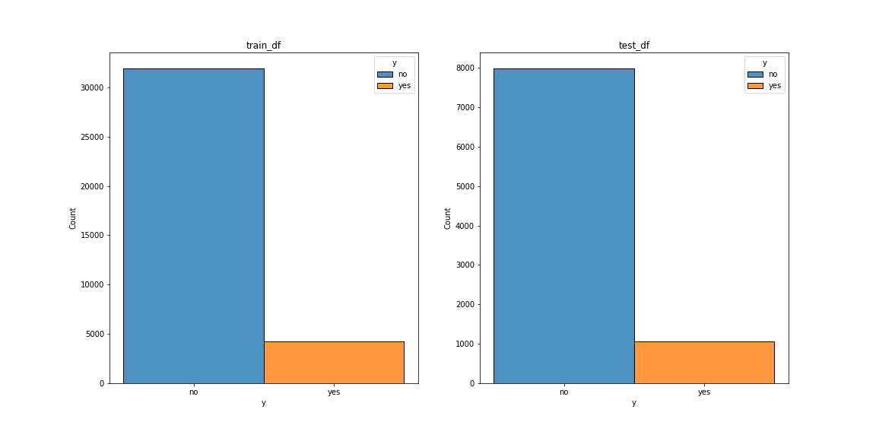
Label “y”
“has the client subscribed a term deposit?” (Binary)
Highly imbalanced with majority belonging to the class(“no”)

Slide 4
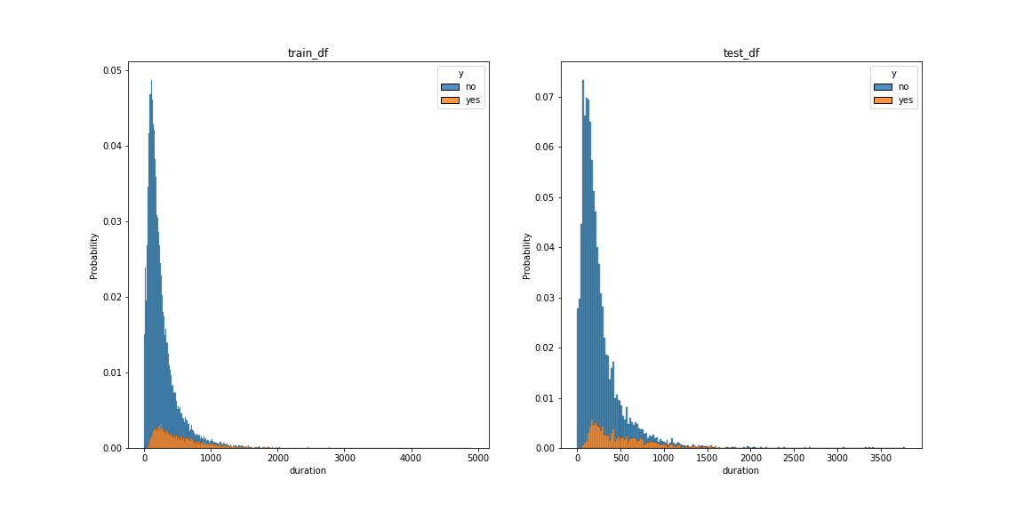
Duration
“last contact duration, in seconds”
In general, higher duration implies higher rate of choosing “yes”
Important for modelss

Slide 5
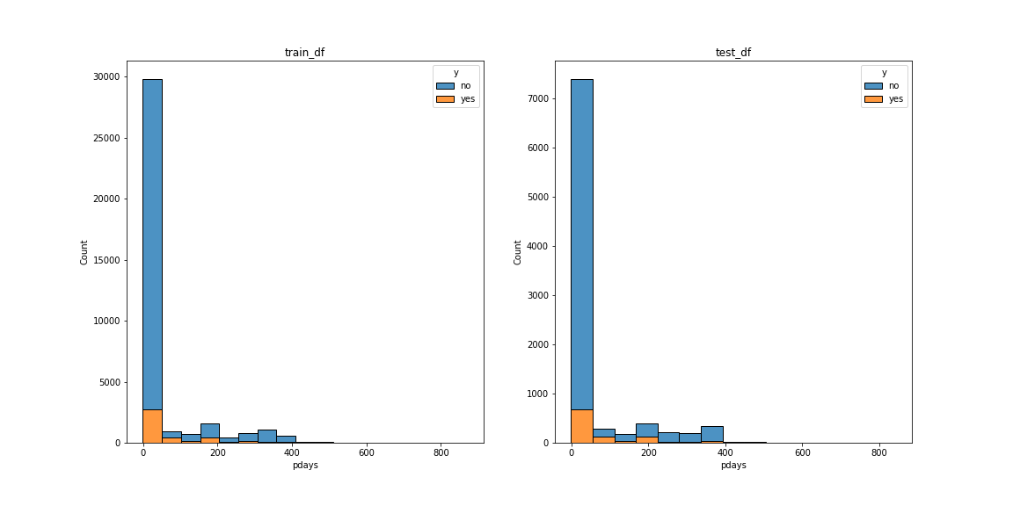
Pdays
“number of days that passed by after the client was last contacted from a previous campaign”
Most clients have never been contacted(>80%)
Imbalanced

Slide 6
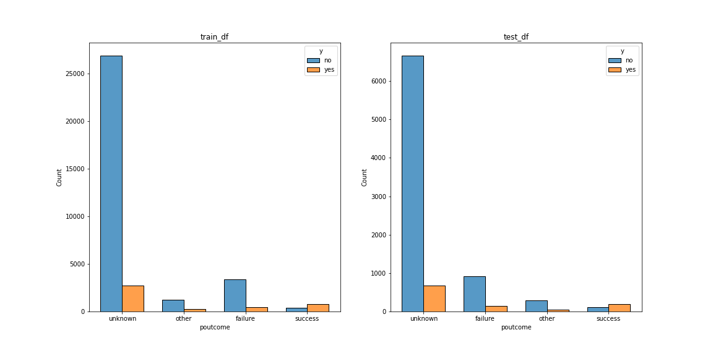
Poutcome
“outcome of the previous marketing campaign”
”success” from previous campaign implies higher possibility of subscription.

Slide 7
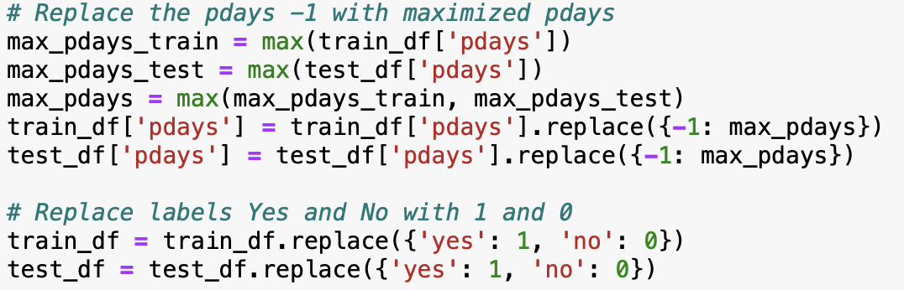
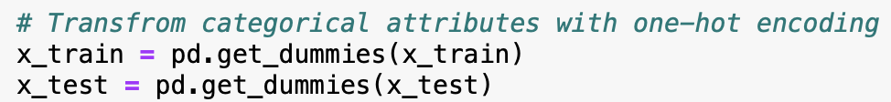
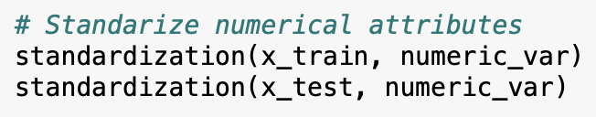
Data preparation
Value modification
One-hot encoding
Standardization
Feature engineering
To be discussed later…

Slide 8
Experiments& Analysis

Slide 9
Selected Models
01
02
03
RandomForest
Decision Tree and KNN
Logistic Regression
and SVM

Slide 10
Decision Tree and KNN
01
Sun Wei

Slide 11
Methodology
Grid search or randomized search
Pick the most important parameter for further exploration based on domain knowledge

Slide 12
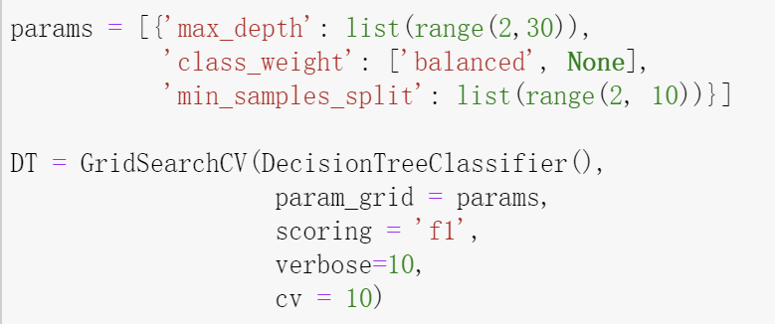
Decision Tree
Parameter Setting
Tuned Hyperparameters:
Best Scores:
class_weight: “balanced”;
max_depth: 2;
min_samples_split: 2
F1 score: 0.38969;
accuracy: 0.63592

Slide 13
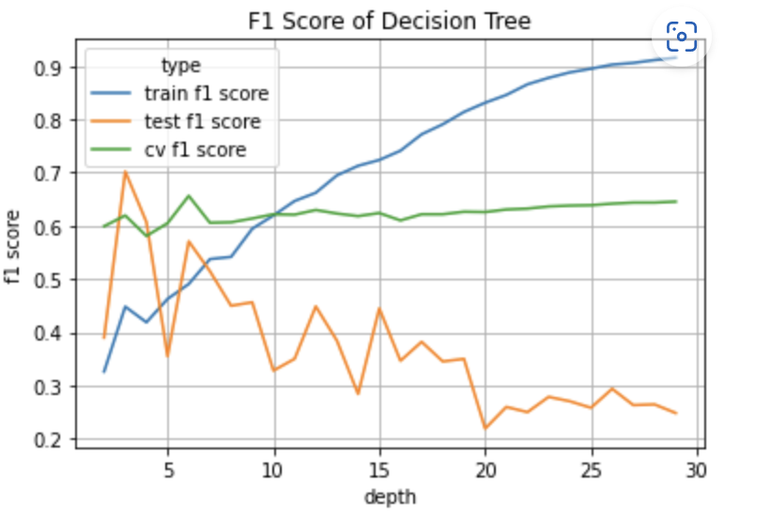
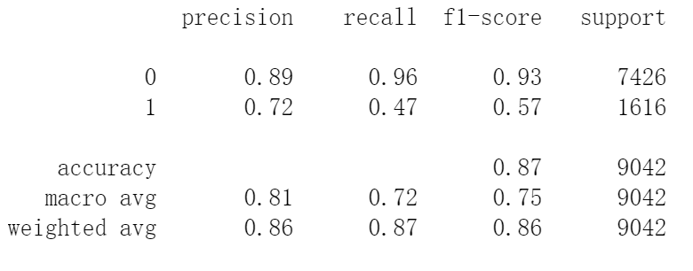
Decision Tree
Parameter selection:
Train F1 score keeps increasing
Cross Validation F1 score reaches
its peak at depth = 6
Tuned Hyperparameters:
class_weight: “balanced”;
max_depth: 6;
min_samples_split: 2
Test Metrics:
Accuracy: 0.87
F1 score: 0.57
Precision: 0.71
Recall: 0.47

Slide 14
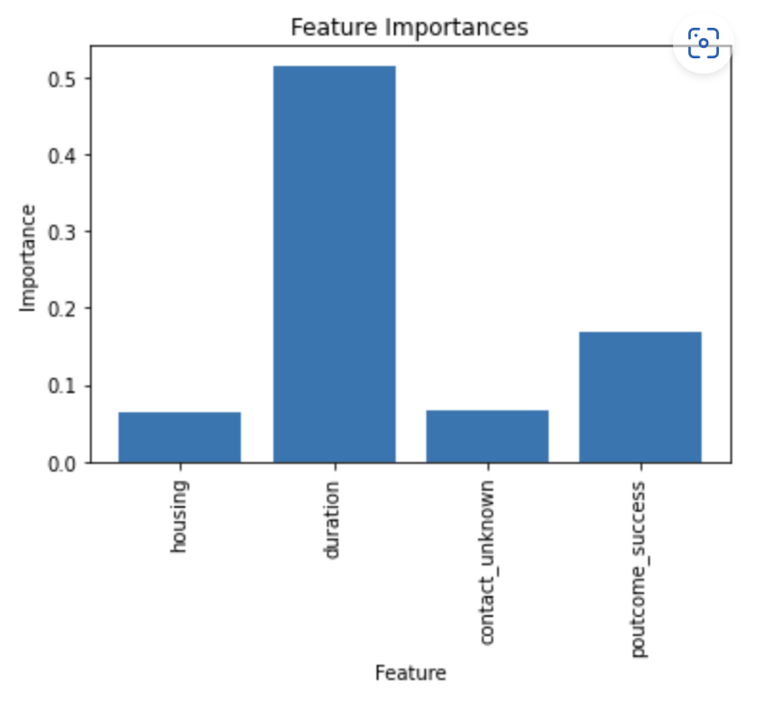
Decision Tree
Criterion:
importance >= 0.05
Feature | importance
duration | 0.5155
poutcome_success | 0.1689
contact_unknown | 0.0669
housing | 0.0634

Slide 15
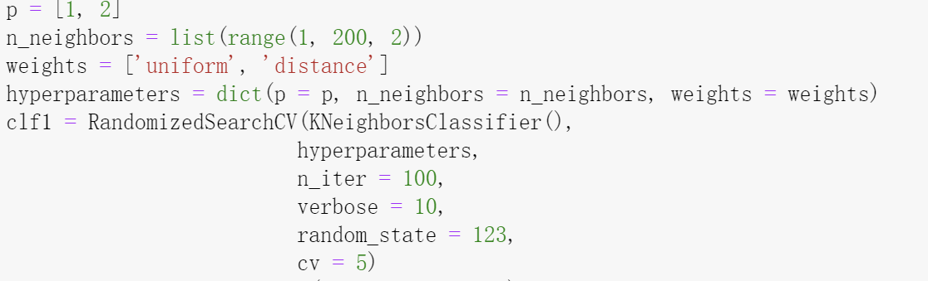
KNN
Parameter Setting
Tuned Hyperparameters:
Best Scores:
n_neighbors: 25;
p: 2;
weights: distance
F1 score: 0.15241;
accuracy: 0.88929

Slide 16
KNN
Problem1: imbalanced data
Solution: Resampling---SVMSMOTE resampling
Problem2: features equal weight
Solution: feature selection----
important features (“duration”, “poutcome_success”)

Slide 17
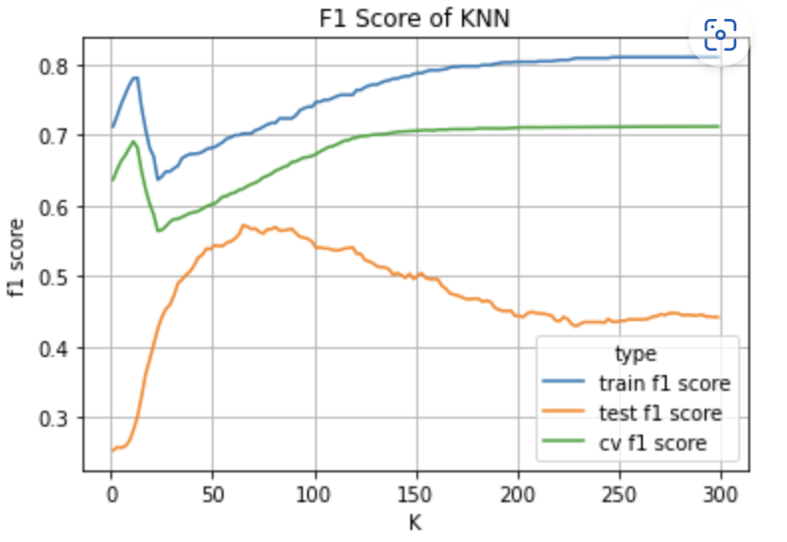

KNN
Parameter selection:
Cross Validation F1 score increases
with K and becomes stable when K
reaches 120
Tuned Hyperparameters:
n_neighbors: 120;
p: 2;
weights: distance
Test Metrics:
Accuracy: 0.84
F1 score: 0.54
Precision: 0.41
Recall: 0.80

Slide 18
Random Forest
02
Lan Rong

Slide 19
Random Forest Classifier
Initial parameters setting:
RandomForestClassifier (n_estimators=100, random_state=1, oob_score=True,class_weight='balanced’
Out-of-bag accuracy prediction : 0.9025
By using the 10-fold cross validation on training data set:
1 | 2 | 3 | 4 | 5 | 6 | 7 | 8 | 9 | 10 | Ave
0.899 | 0.903 | 0.904 | 0.904 | 0.900 | 0.906 | 0.909 | 0.900 | 0.902 | 0.900 | 0.903

Slide 20
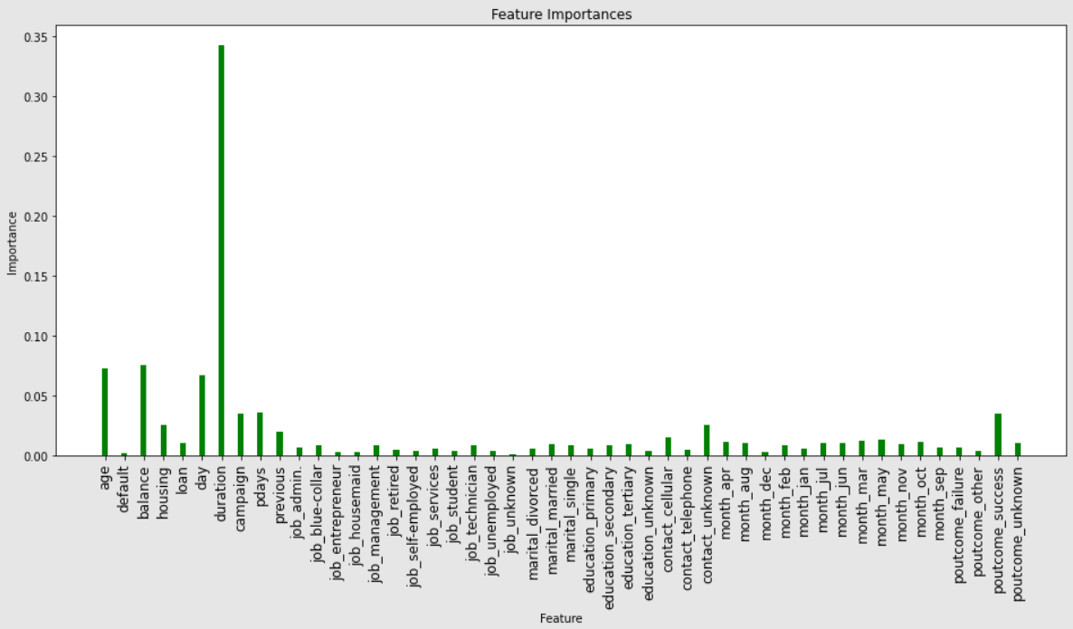
Random Forest Classifier
The accuracy score of testing data set: 0.9015
Feature importance:

Slide 21
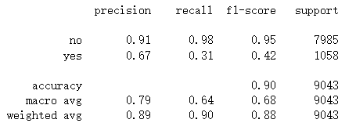
Random Forest Classifier
Classification report:
Model Evaluation:
n_estimators:[10,50,100,150,300,500,800,1200]
max_depth:[3,5,8,15,25,30]

Slide 22
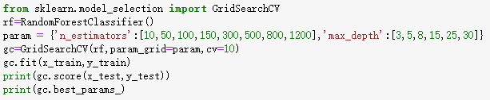
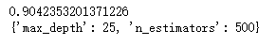
Random Forest Classifier
Model Evaluation:
To choose the best the parameters with best score:
The accuracy score of testing data set before the model evaluation: 0.9015

Slide 23
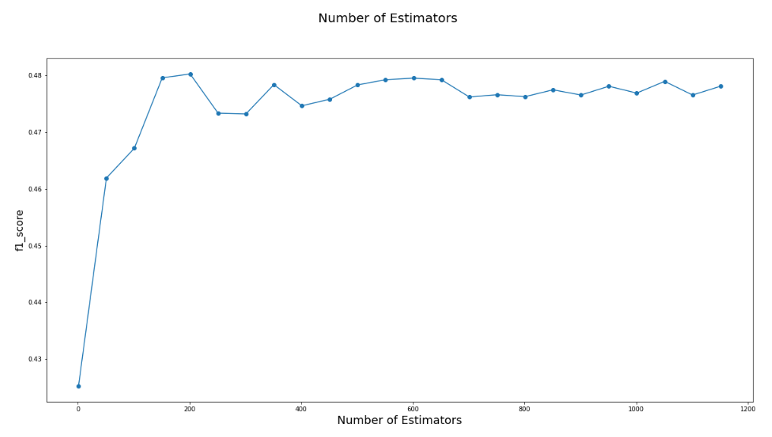
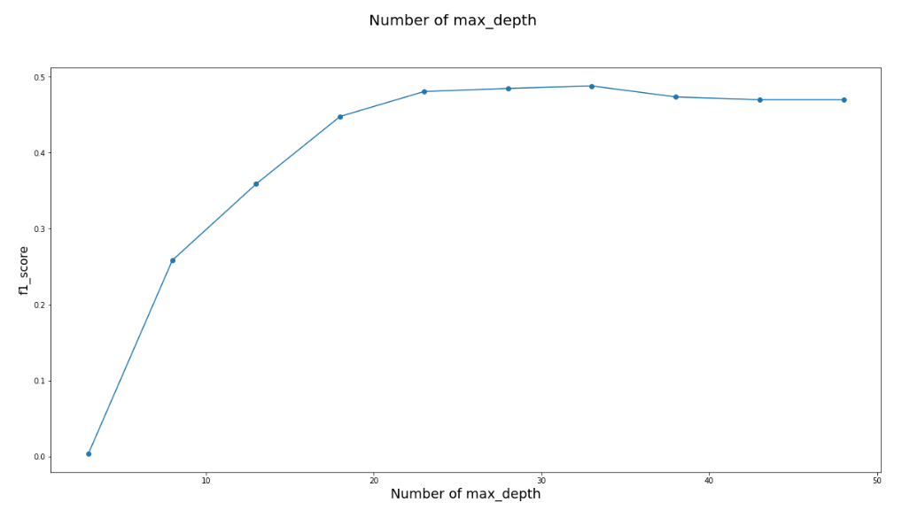
Random Forest Classifier
To choose the best the parameters with best f1_score:
The F1 score for testing data set: 0.4902

Slide 24
Logistic Regression vs SVM
03
XIONG Jiajie

Slide 25
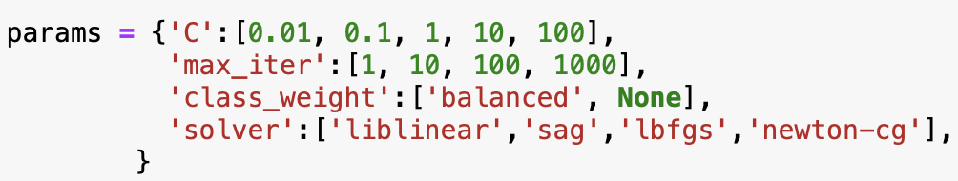
LR: Hyperparameter tuning
Parameter table
GridSearchCV
Fitting 5 folds for each of 160 candidates, totalling 800 fits

Slide 26
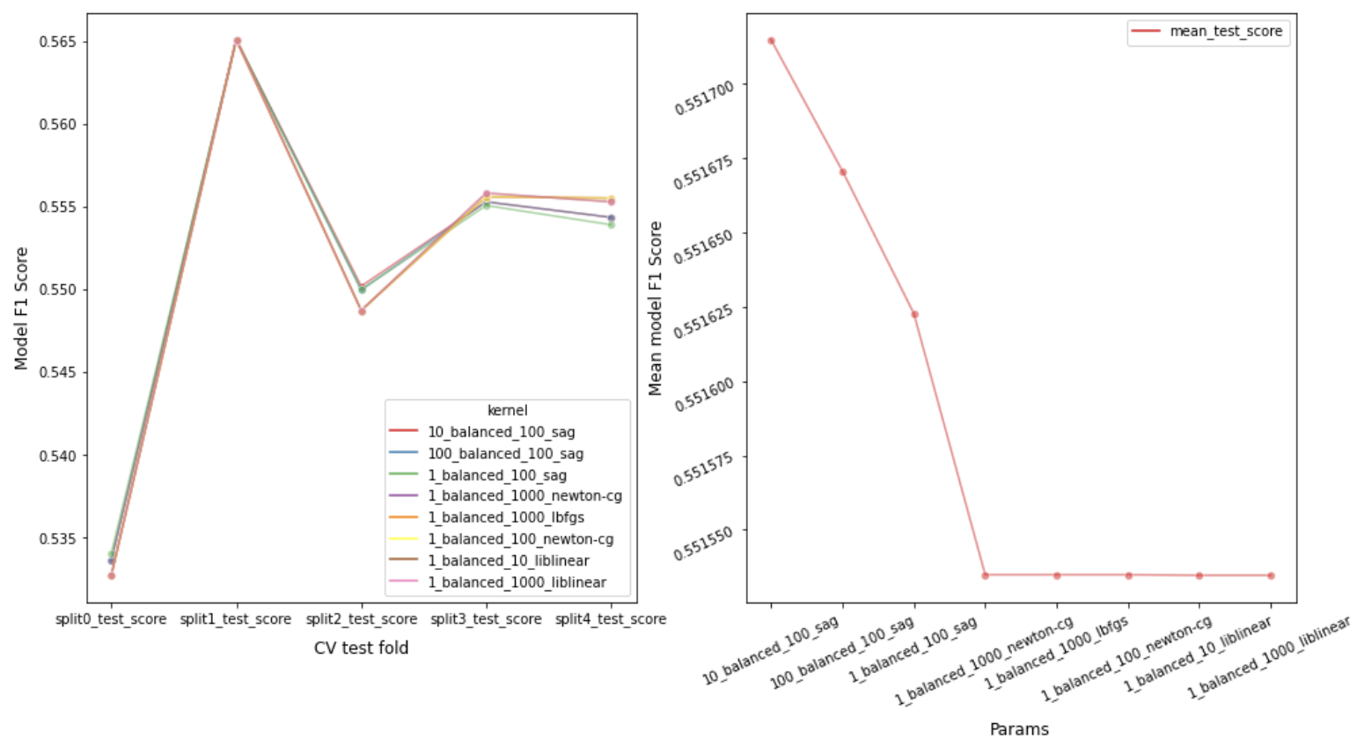
Best estimator (Base line)
Tuned Hyperparameters:
Fig 1.
Plot top 8 models with best scores between cv fold and f1 score
Fig 2.
Average f1 score of those top 8 models
Best train score:
0.551715
C: 10; class_weight: “balanced”; max_iter: 100; solver: “sag”

Slide 27
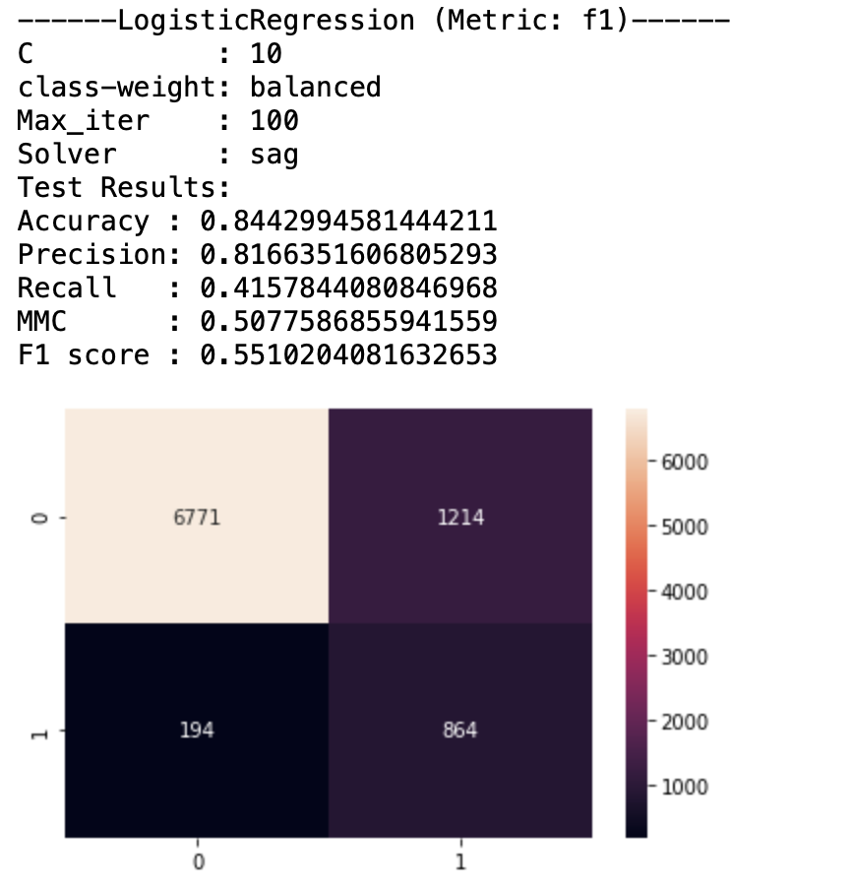
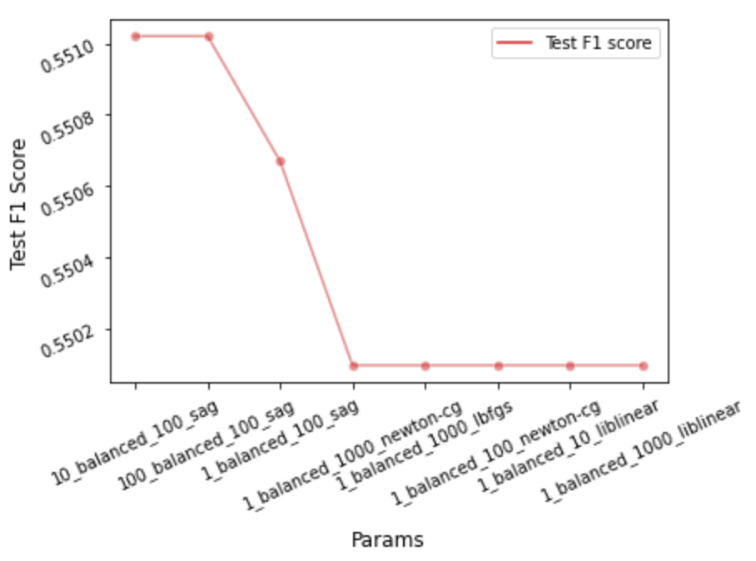
Model testing
Observation:
Fig 1.
Test result of our base line estimator “10_balanced_100_sag”
Fig 2.
Test f1 score of those top 8 models
Best test score:
0.551020
Result of test scores are in accordance with results in training phase.

Slide 28
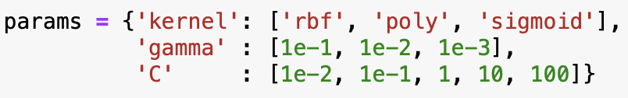
SVM: Hyperparameter tuning
Parameter table
GridSearchCV
Fitting 3 folds for each of 45 candidates, totalling 135 fits

Slide 29
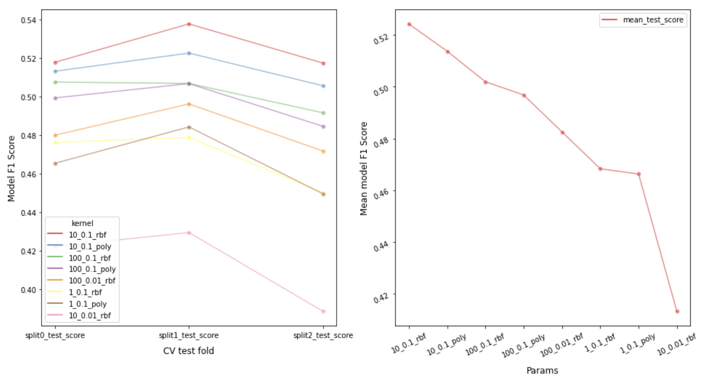
Best estimator (Base line)
Tuned Hyperparameters:
Fig 1.
Plot top 8 models with best scores between cv fold and f1 score
Fig 2.
Average f1 score of each model
Best train score:
0.524287
C: 10; gamma: 0.1; kernel: “rbf”

Slide 30
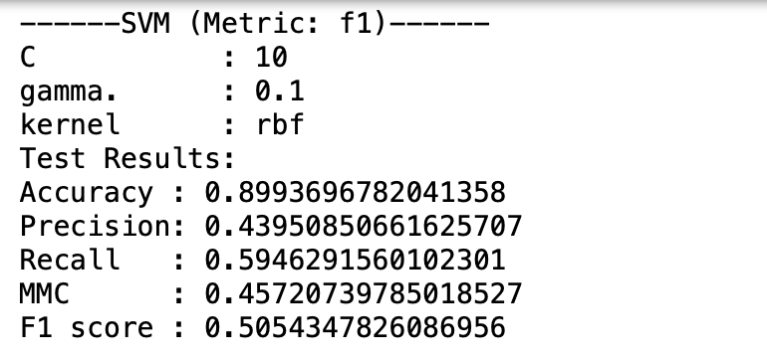
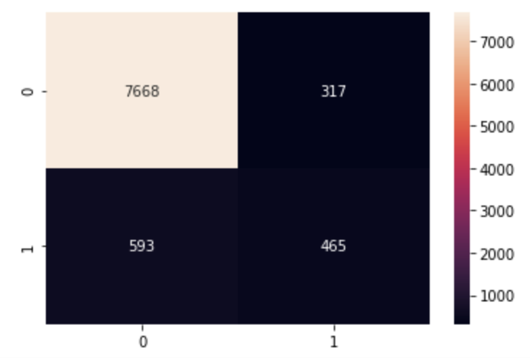
Model testing
Observation:
Fig 1.
Test result of our base line estimator “10_balanced_100_sag”
Best test score:
0.505435
1) Performance is not as good as Logistic Regression.
2) It took a long time to fit data, possibly due to too many features.

Slide 31
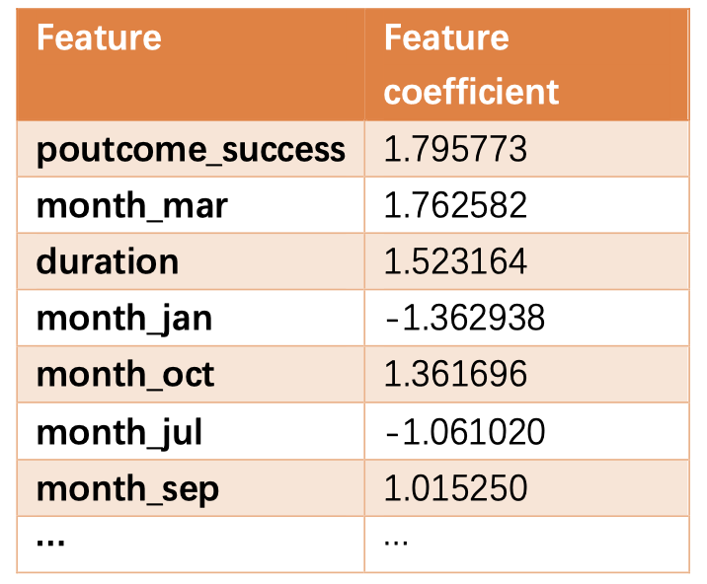
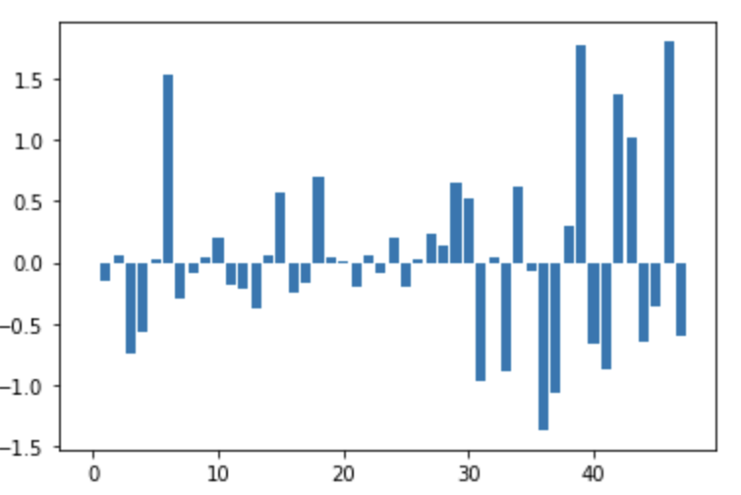
Feature selection
Observation:
Fig 1.
Some important features and their coefficient
Fig 2.
Feature coefficients distribution of all 48 features
1) A negative coefficient means that higher value of the corresponding feature pushes the classification more towards the negative class.
2) Some feature coefficients are near 0

Slide 32
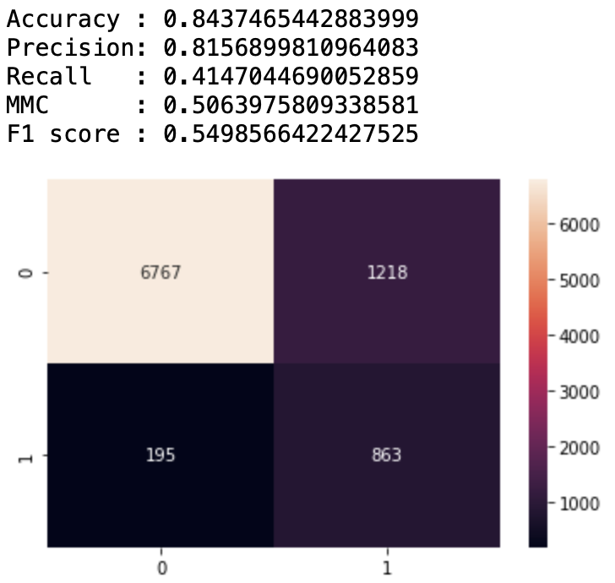
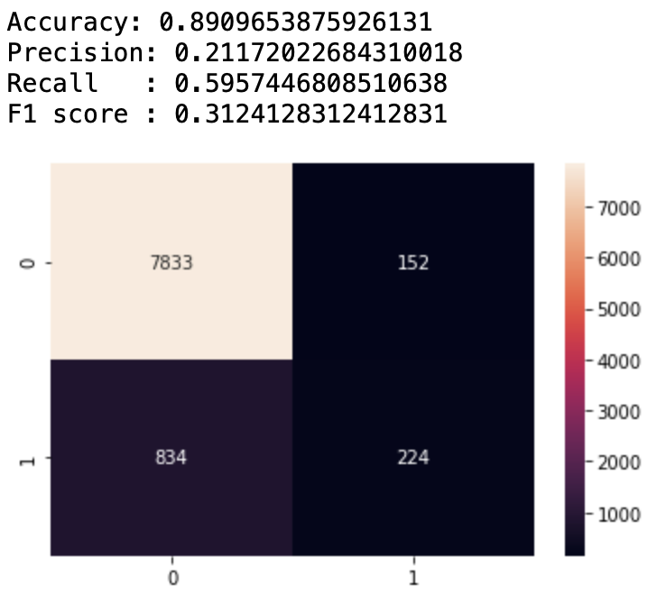
Feature selection-Results
Observation:
LR
SVM
Simply dropping some features with low feature coefficients, e.g. age, job_unemployed did not help improve the model performance, but could speed up training process.

Slide 33
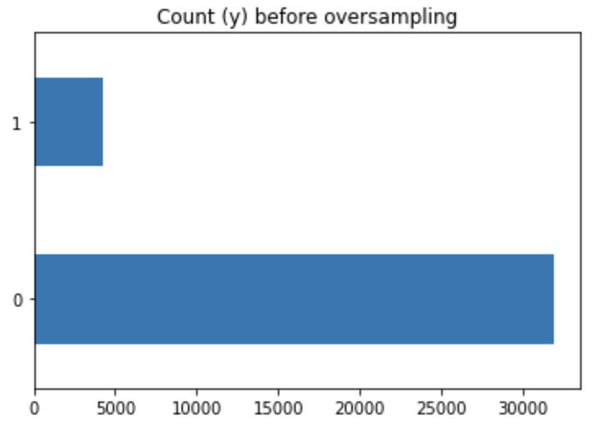
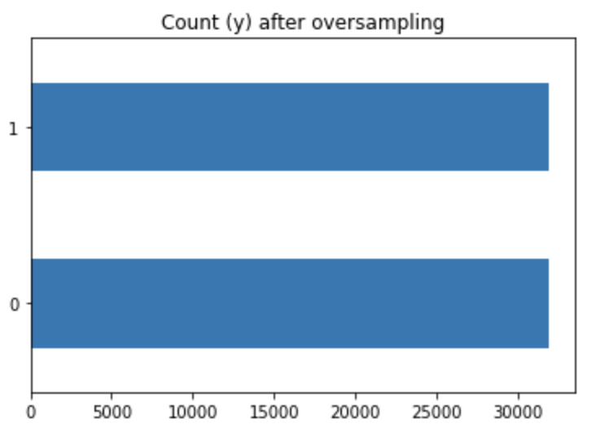
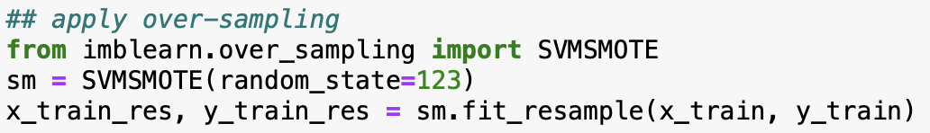
Oversampling
Observation:
Fig 1.
Value distribution of ‘y’ before oversampling
Fig 2.
Value distribution of ‘y’ after oversampling
‘y’ is highly imbalanced with majority belonging to class(‘no’), i.e. 0.

Slide 34
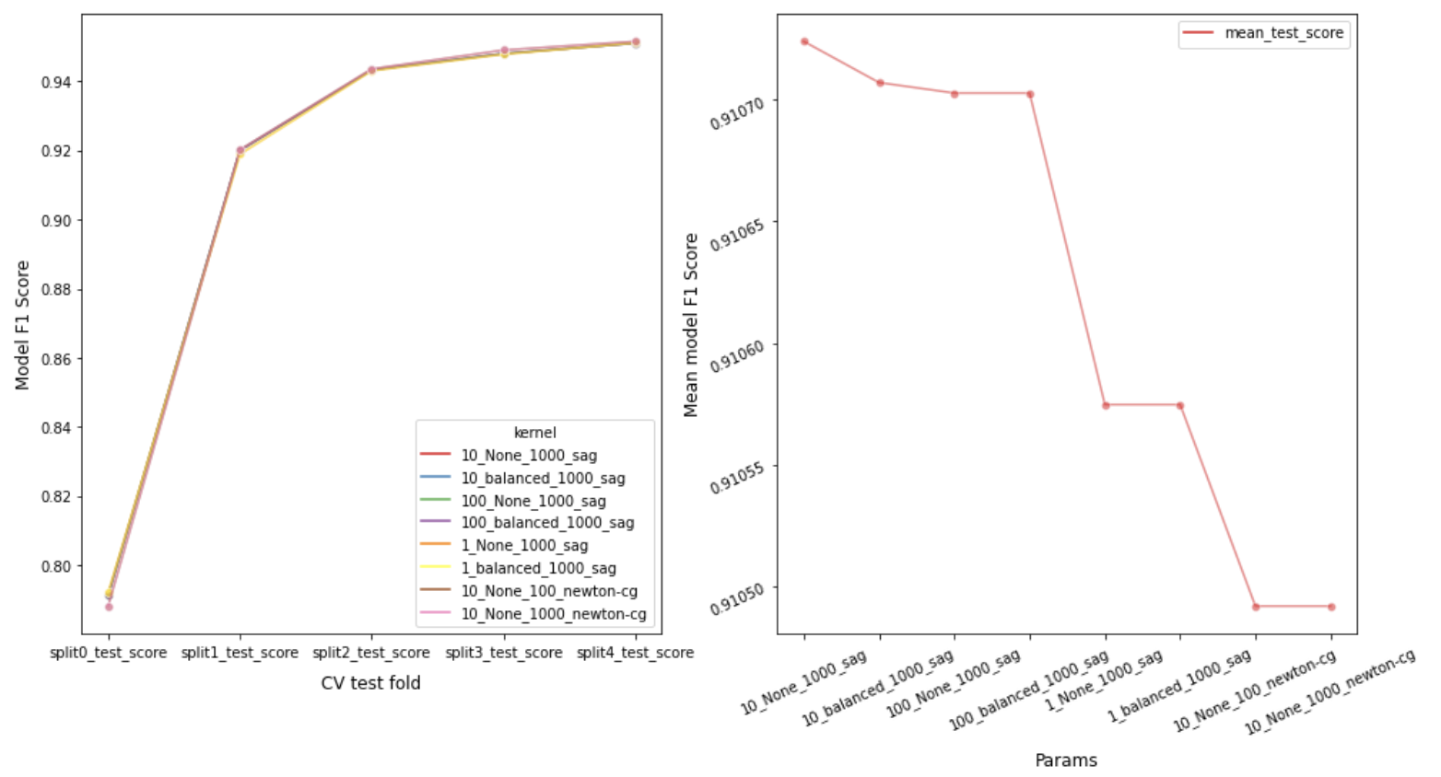
Oversampling-train(LR)
Tuned Hyperparameters:
Fig 1.
Plot top 8 models with best scores between cv fold and f1 score
Fig 2.
Average f1 score of each model
Best train score:
0.910724
C: 10; class_weight: None; max_iter: 1000; solver: “sag”

Slide 35
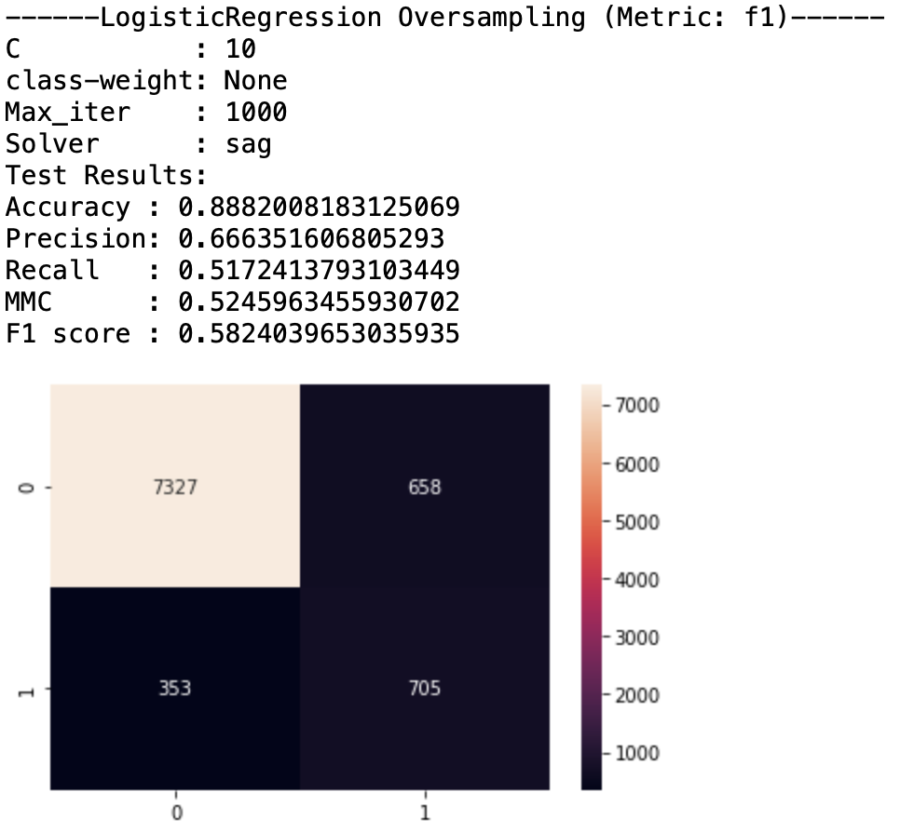
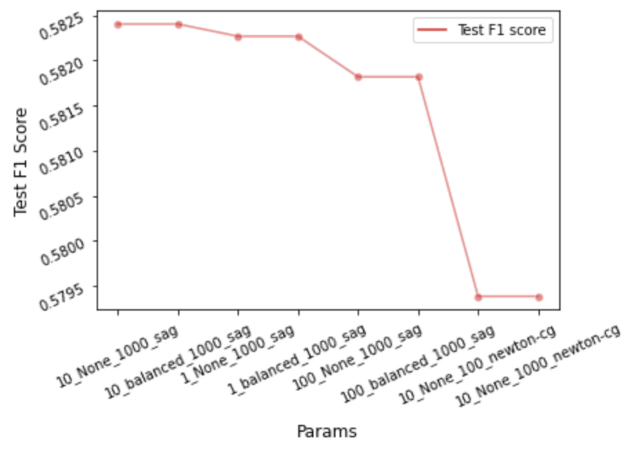
Oversampling-test(LR)
Observation:
Fig 1.
Test result of best estimator “10_None_1000_sag”
Fig 2.
Test f1 score of the top 8 models
Best test score:
0.582404
We can observe f1 score improvement from “0.551020” to “0.582404”.

Slide 36
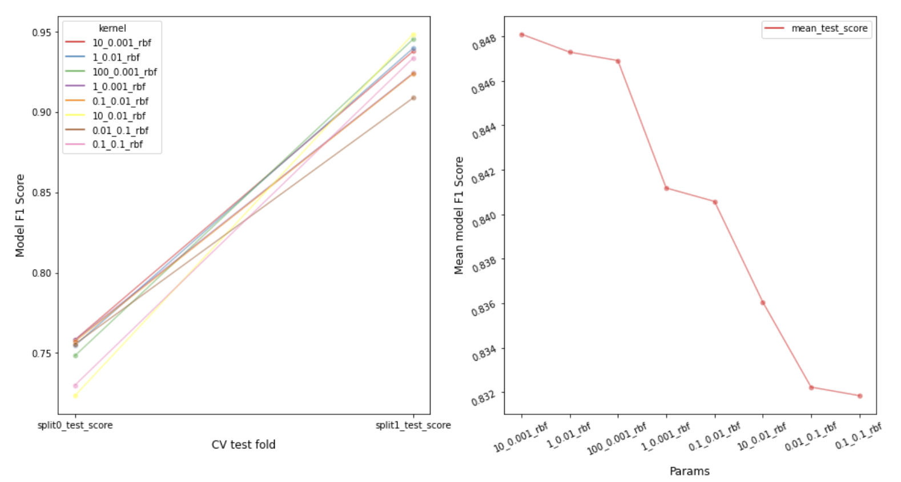
Oversampling-train(SVM)
Tuned Hyperparameters:
Fig 1.
Plot top 8 models with best scores between cv fold and f1 score
Fig 2.
Average f1 score of each model
Best train score:
0.848101
C: 10; gamma: 0.001; kernel: “rbf”

Slide 37
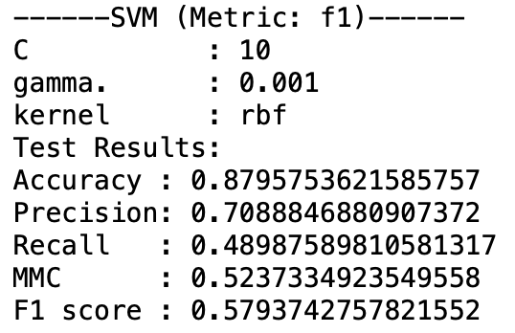
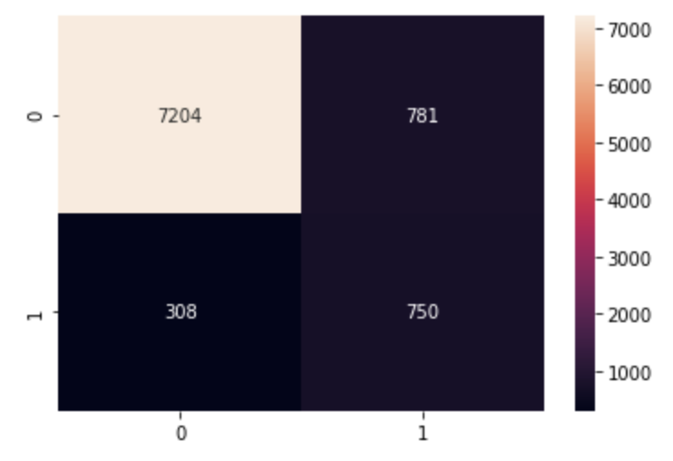
Oversampling-test(SVM)
Observation:
Fig 1.
Test result of best estimator “10_None_1000_sag”
Fig 2.
Test f1 score of the top 8 models
Best test score:
0.579374
We can observe f1 score improvement from “0.505435” to “0.579374”.

Slide 38
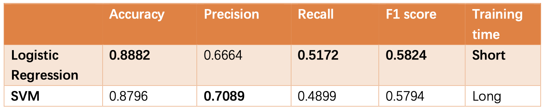
LR vs SVM
Observation:
1) LR has higher accuracy, recall, f1 score and shorter training time. SVM has higher precision and much longer training time.
2) If mainly considering f1 and training time, LR is better than SVM.

Slide 39
Summary & Analysis

Slide 40
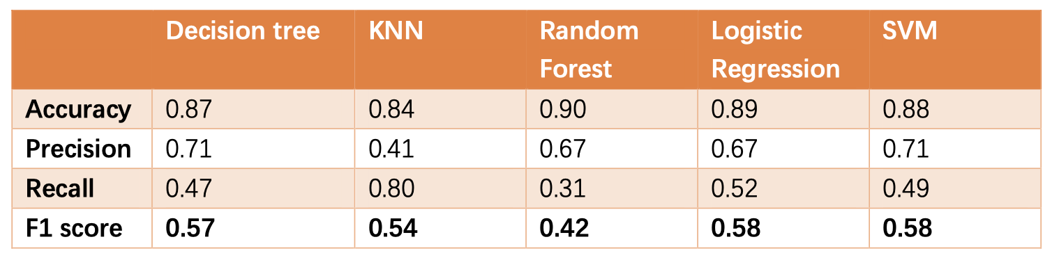
Model Summary
Observation:
1) Using f1 score as metric, Logistic Regression model has the best performance.
2) F1 scores for most of our models are higher than 0.5.

Slide 41
Analysis
Model selection
Hyperparameters have huge impact on model performances.
Training time is also an important metric while choosing our models.
Feature engineering
Select important features by feature importance can help build useful models.
Feature selection may have distinct performances on different algorithms.

Slide 42
Future Improvements
Model selection
Consider conducting experiments on more algorithms.
Generate more detailed parameter tables during hyperparameter tuning.
Applying additional speed-up algorithms to grid search.
Feature engineering
For some features, conduct experiments on ordinal encoding instead of one-hot encoding.
Apart from selecting important features, try generating new features from existing ones.

Slide 43
THANKS

